Slide 1

Exploratory Data Analysis in Python
GROUP 3
Siddhant Shinde
Anushree Khopkar
Kuntal Surwade
Helee Rana

Slide 2
Abstract
FIFA is the Fédération Internationale de Football Association and FIFA 19 is part of the FIFA series of association football video games. It is one of the best-selling video games of all time selling over 260 million copies to date.
FIFA 19 is a football simulation video game developed by EA Vancouver as part of Electronic Arts’ FIFA series.

Slide 3
Introduction
This is a project based on the FIFA World Cup 2019.
We have performed some Exploratory Data Analysis(EDA) on the FIFA game dataset of the year 2019, to derive important conclusions that are integral in making decisions for the next season.
We have done data exploration, created visualizations to understand the conclusions easily.

Slide 4

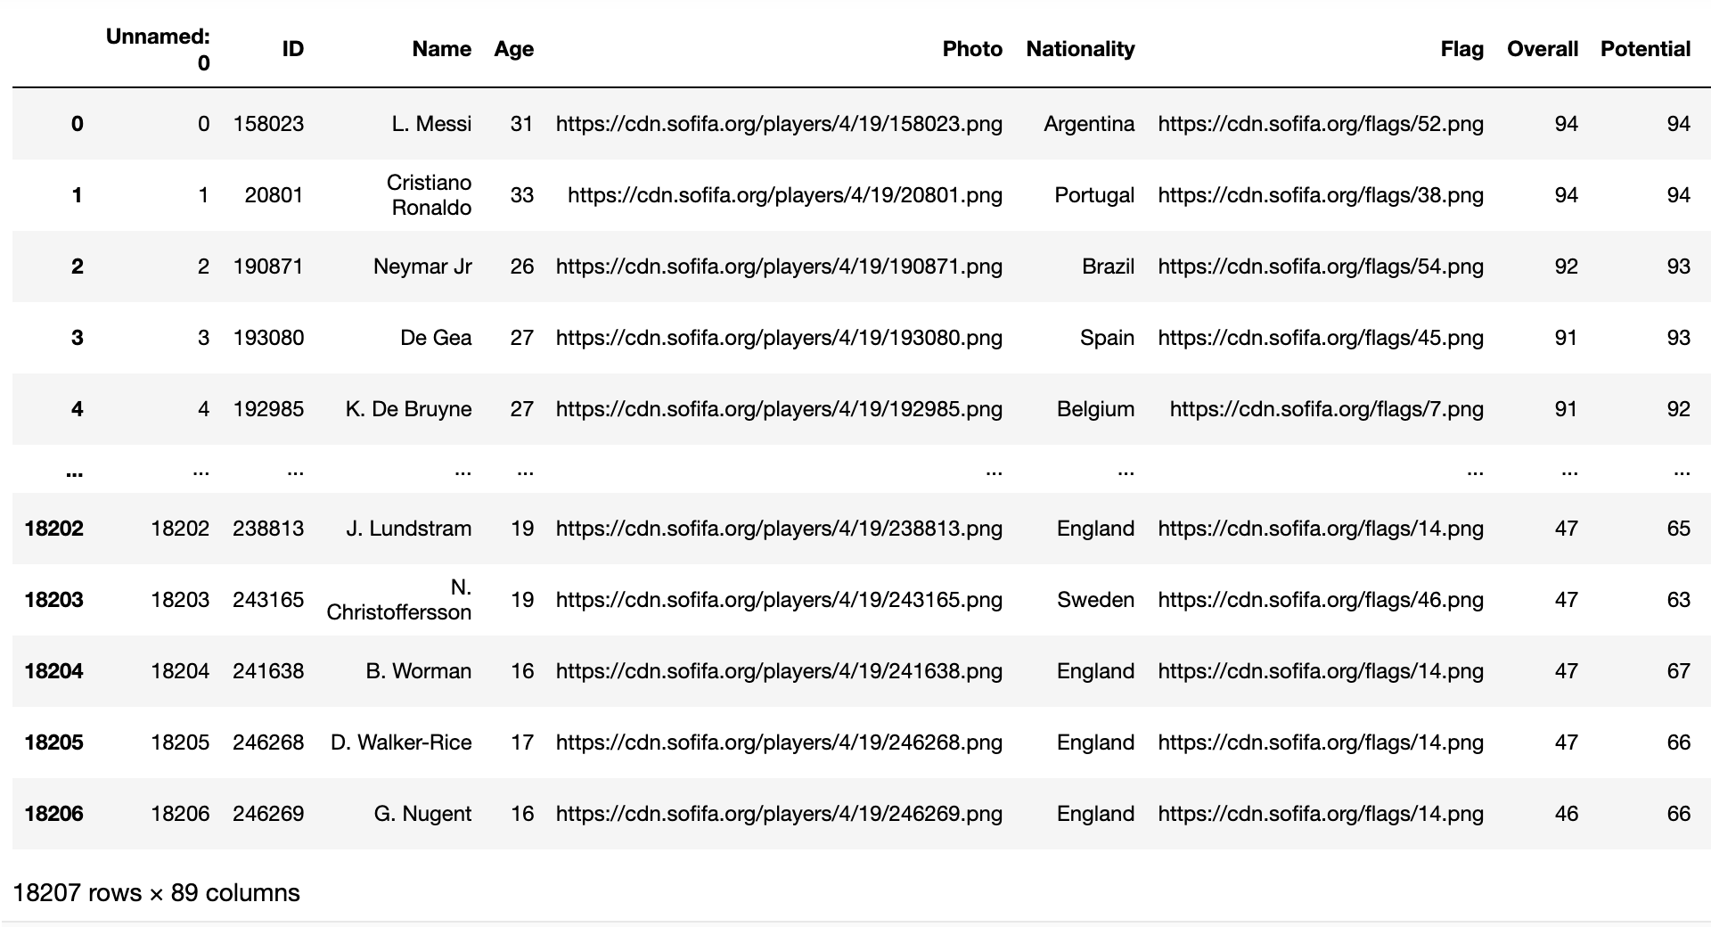
We have taken Dataset from Kaggle
89 attributes including personal information like age, name, nationality, club, wage, etc, and also player skill information like ball control, dribbling, crossing, finishing, GK skills and etc.
Link to Dataset : -https://www.kaggle.com/karangadiya/fifa19

Slide 5
Data Pre-Processing
Out dataset consists of a combination of numerical and categorical values. As we had many NA/missing values in our dataset, we have removed and replaced those values.
Columns with Numeric Values Example: Short-Passing, Finishing | Replaced by Mean of other values
Columns with Categorical Values Example: Height, Club | Replaced by random values
Other Columns | Replaced by 0

Slide 6
Literature Review
Columns used | Description | Link
Age, Player Value | EDA on Age vs logarithmically transformed player value. Achieved a smooth curve capturing the trend. | https://pbiecek.github.io/ema/UseCaseFIFA.html
Overall | Plotted the average distribution of overall rating | https://rohitmidha23.github.io/FIFA-19/

Slide 7

Questions
Q1. Which was the most used/ preferred foot used by FIFA players in 2019
Q2. What were the popular positions during the FIFA season?
Q3. What is the range of heights of players who are a part of FIFA?
Q4. Which nations participated in the FIFA 19 season?
Q5. Based on the overall score of players, which clubs are at top on the charts?

Slide 8
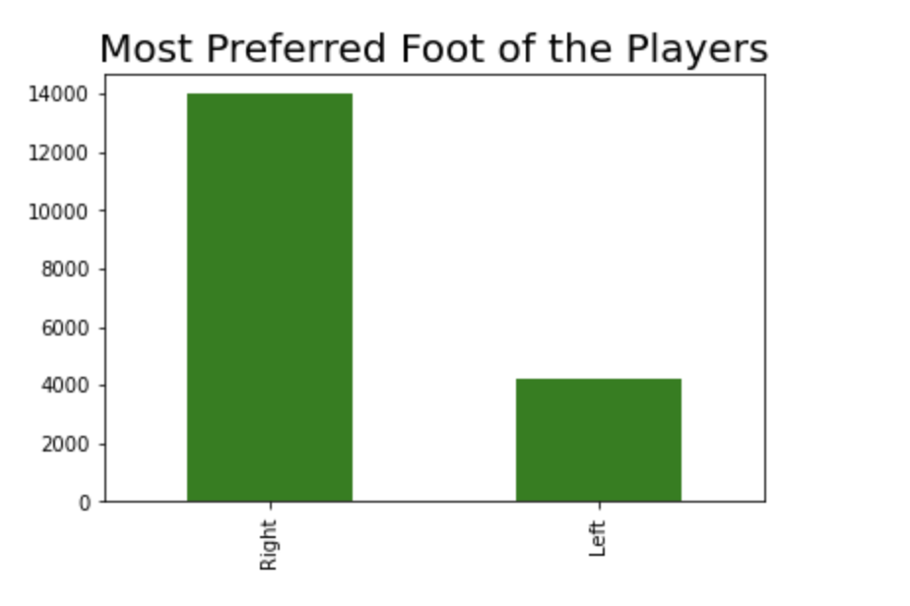
Insights

Slide 9
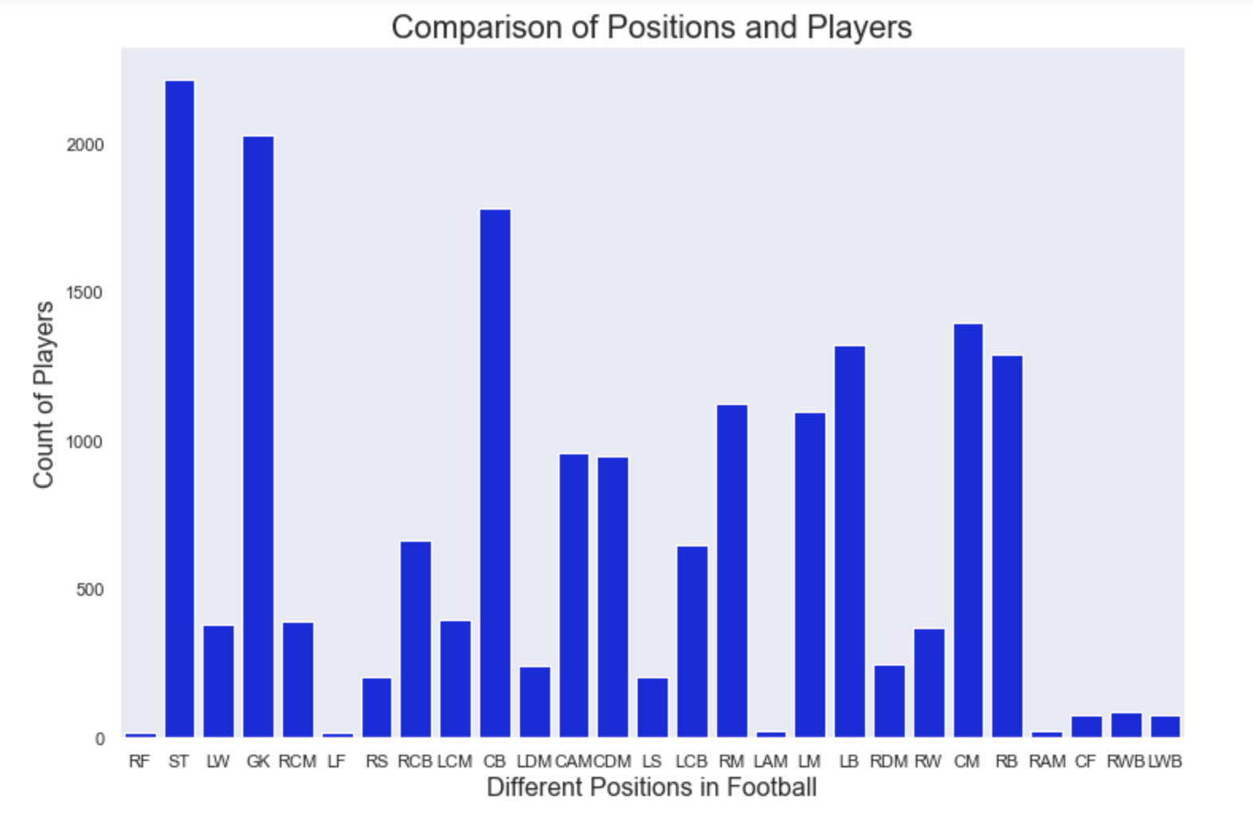
Insights

Slide 10
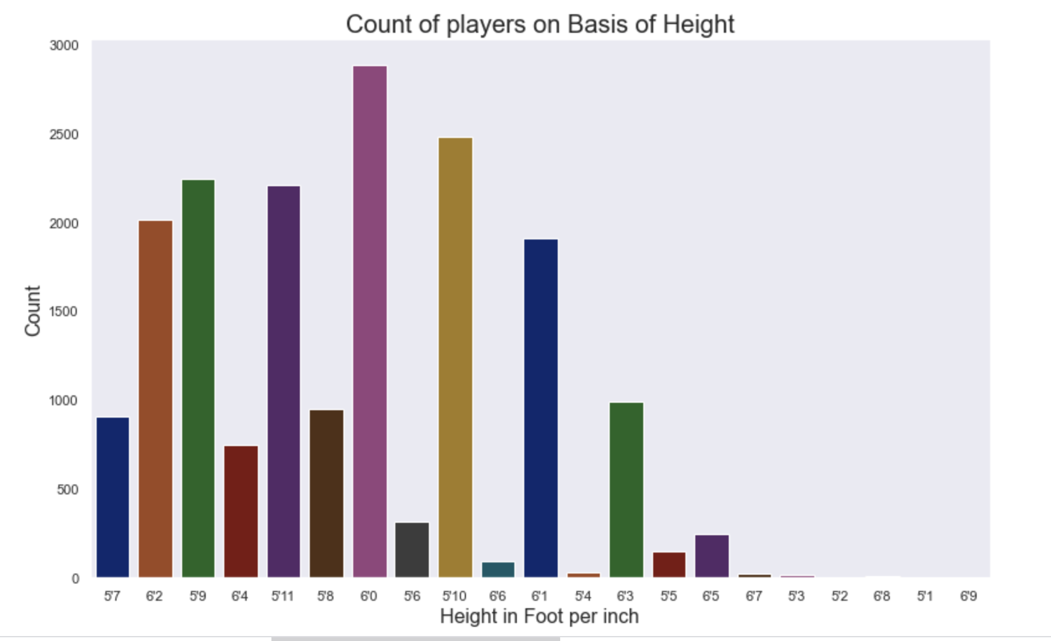
Insights

Slide 11
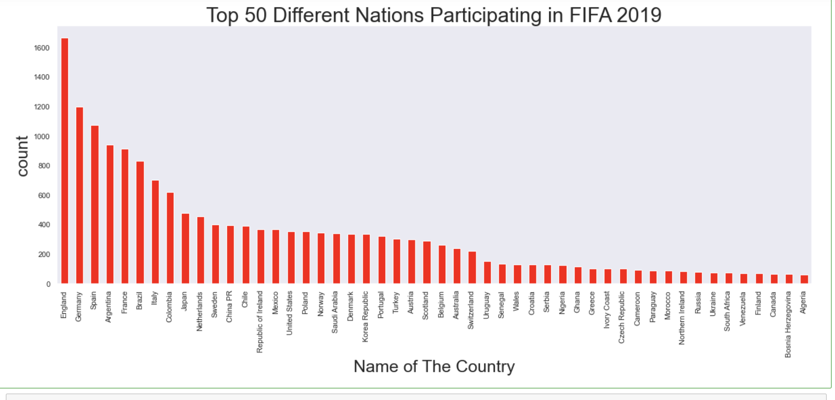
Insights

Slide 12
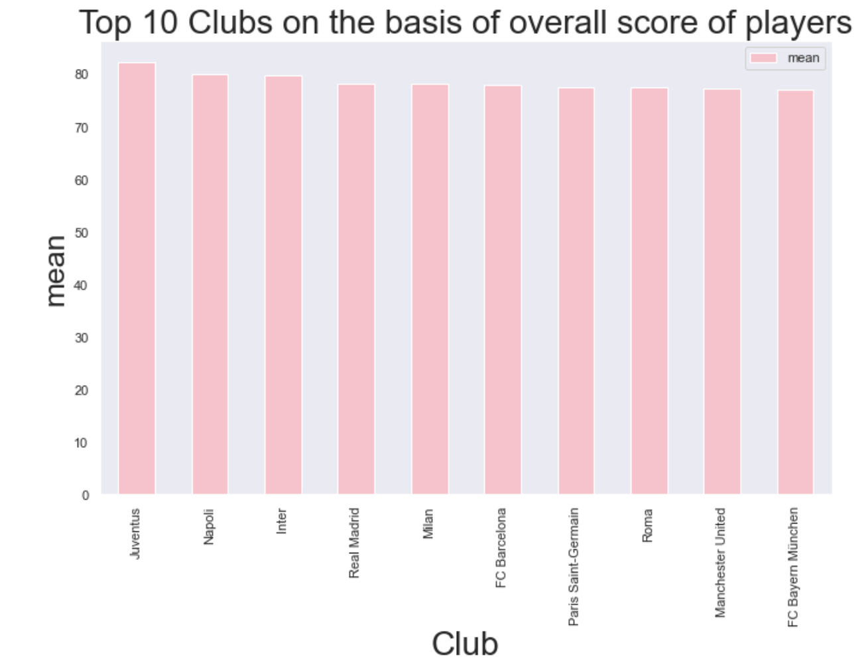
Insights

Slide 13
Result and Conclusion
The following insights were generated from the visualizations
Right foot was used more than left foot
Standing Tackle(ST) was the most popular position during the season
Highest number of players have their heights in between 5’9 to 6’1.
England is the top-most country whose players participate in the FIFA world cup season, followed by Germany, Spain and Argentina
Players with a best overall scores belong to clubs Juventus, Inter, Real Madrid

Slide 14
Future Work
Implementation of classification algorithms like KNN, Naïve Bayes and classify the characteristics of players and find outcomes
Implementation of decision trees with respect to player details like potential or other skill types by converting the values to Boolean first.

